Slide 1

Le recommandeur
A Music Recommendation System Enhanced by NLP
Abdullah Palaz, Gökalp Özer, Mete Mert Birdal
Illustration from workingnotworking.com by 82952-ryan

Slide 2

Problem: Definition
There are vast amount of data available in these years.
Finding “related” or “good enough” data points among variety of options is a problem to tackle. A sample: yielding related websites using keywords.
This problem can be extended to music domain.

Slide 3
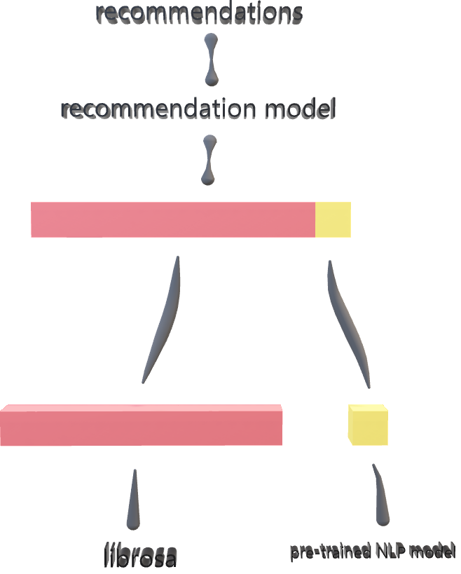
How to: Le recommandeur
We first extract audio features.
In addition to audio features, the mood of the song lyrics is extracted for the sake of enhancement.
We combine these features to estimate your music taste.
This is called content-based recommendation. There are also other approaches such as collaborative filtering or hybrid models.

Slide 4
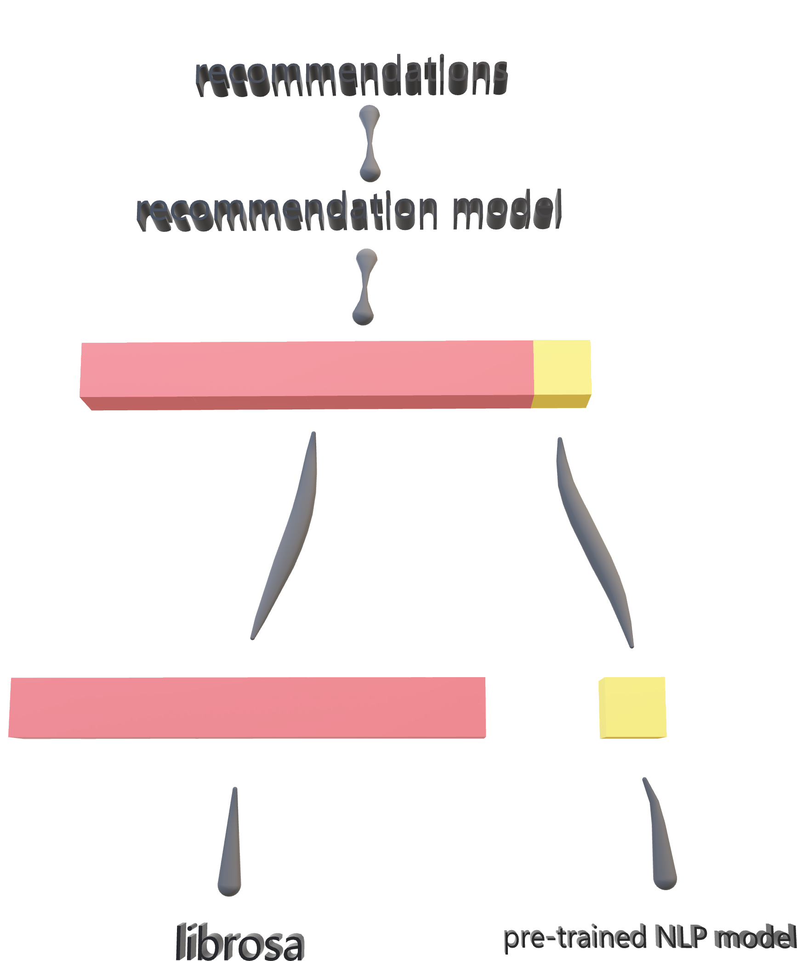
Mood Information
extracted from song lyrics
Audio Features
extracted using librosa library

Slide 5
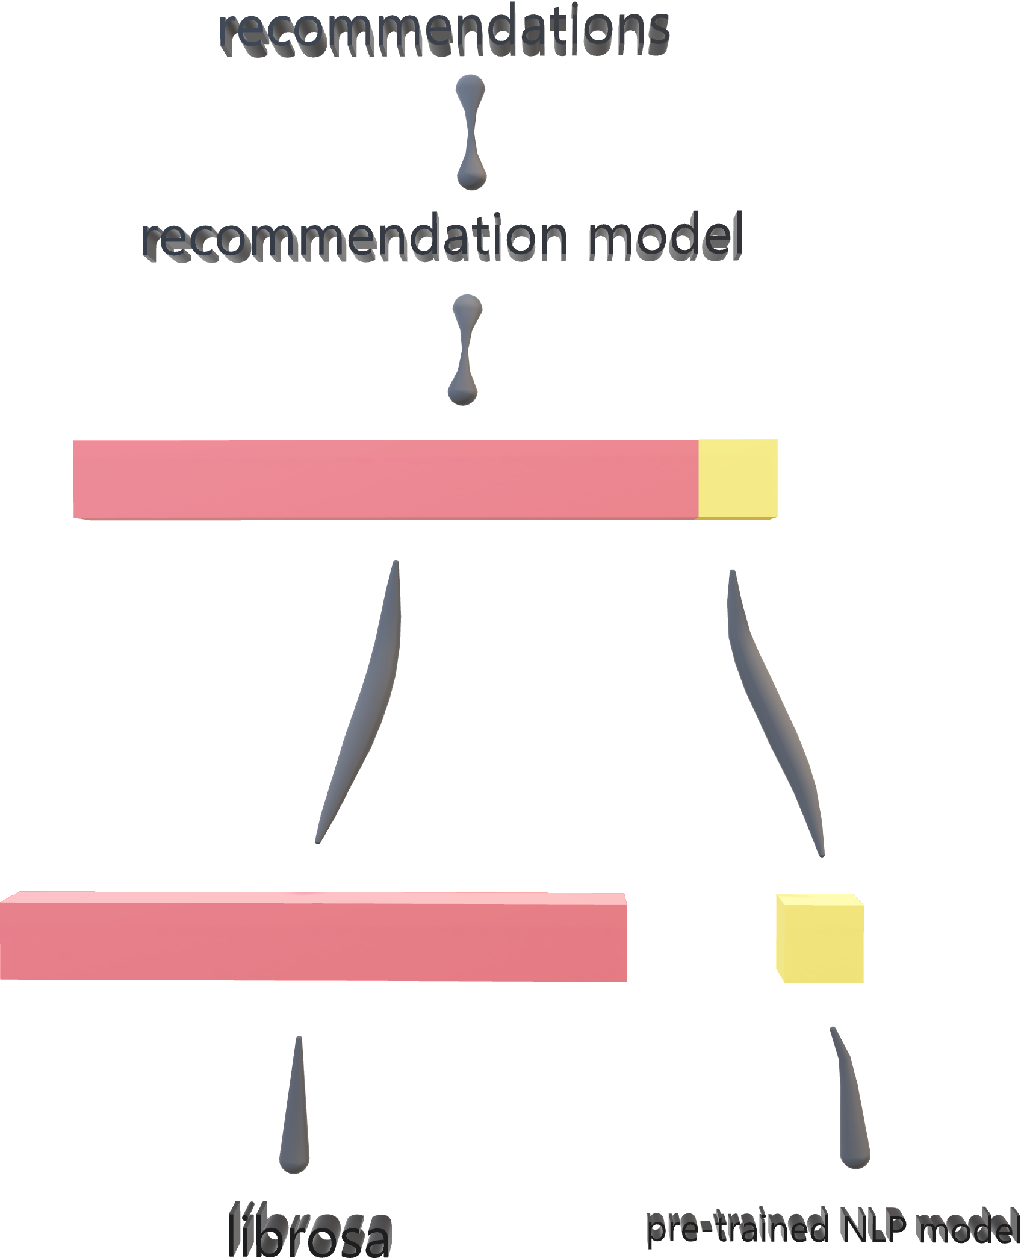
Concatenated features
that will be fed to our favorite recommendation model
Concatenation
for creating a representation that is capable of representing a song truly

Slide 6
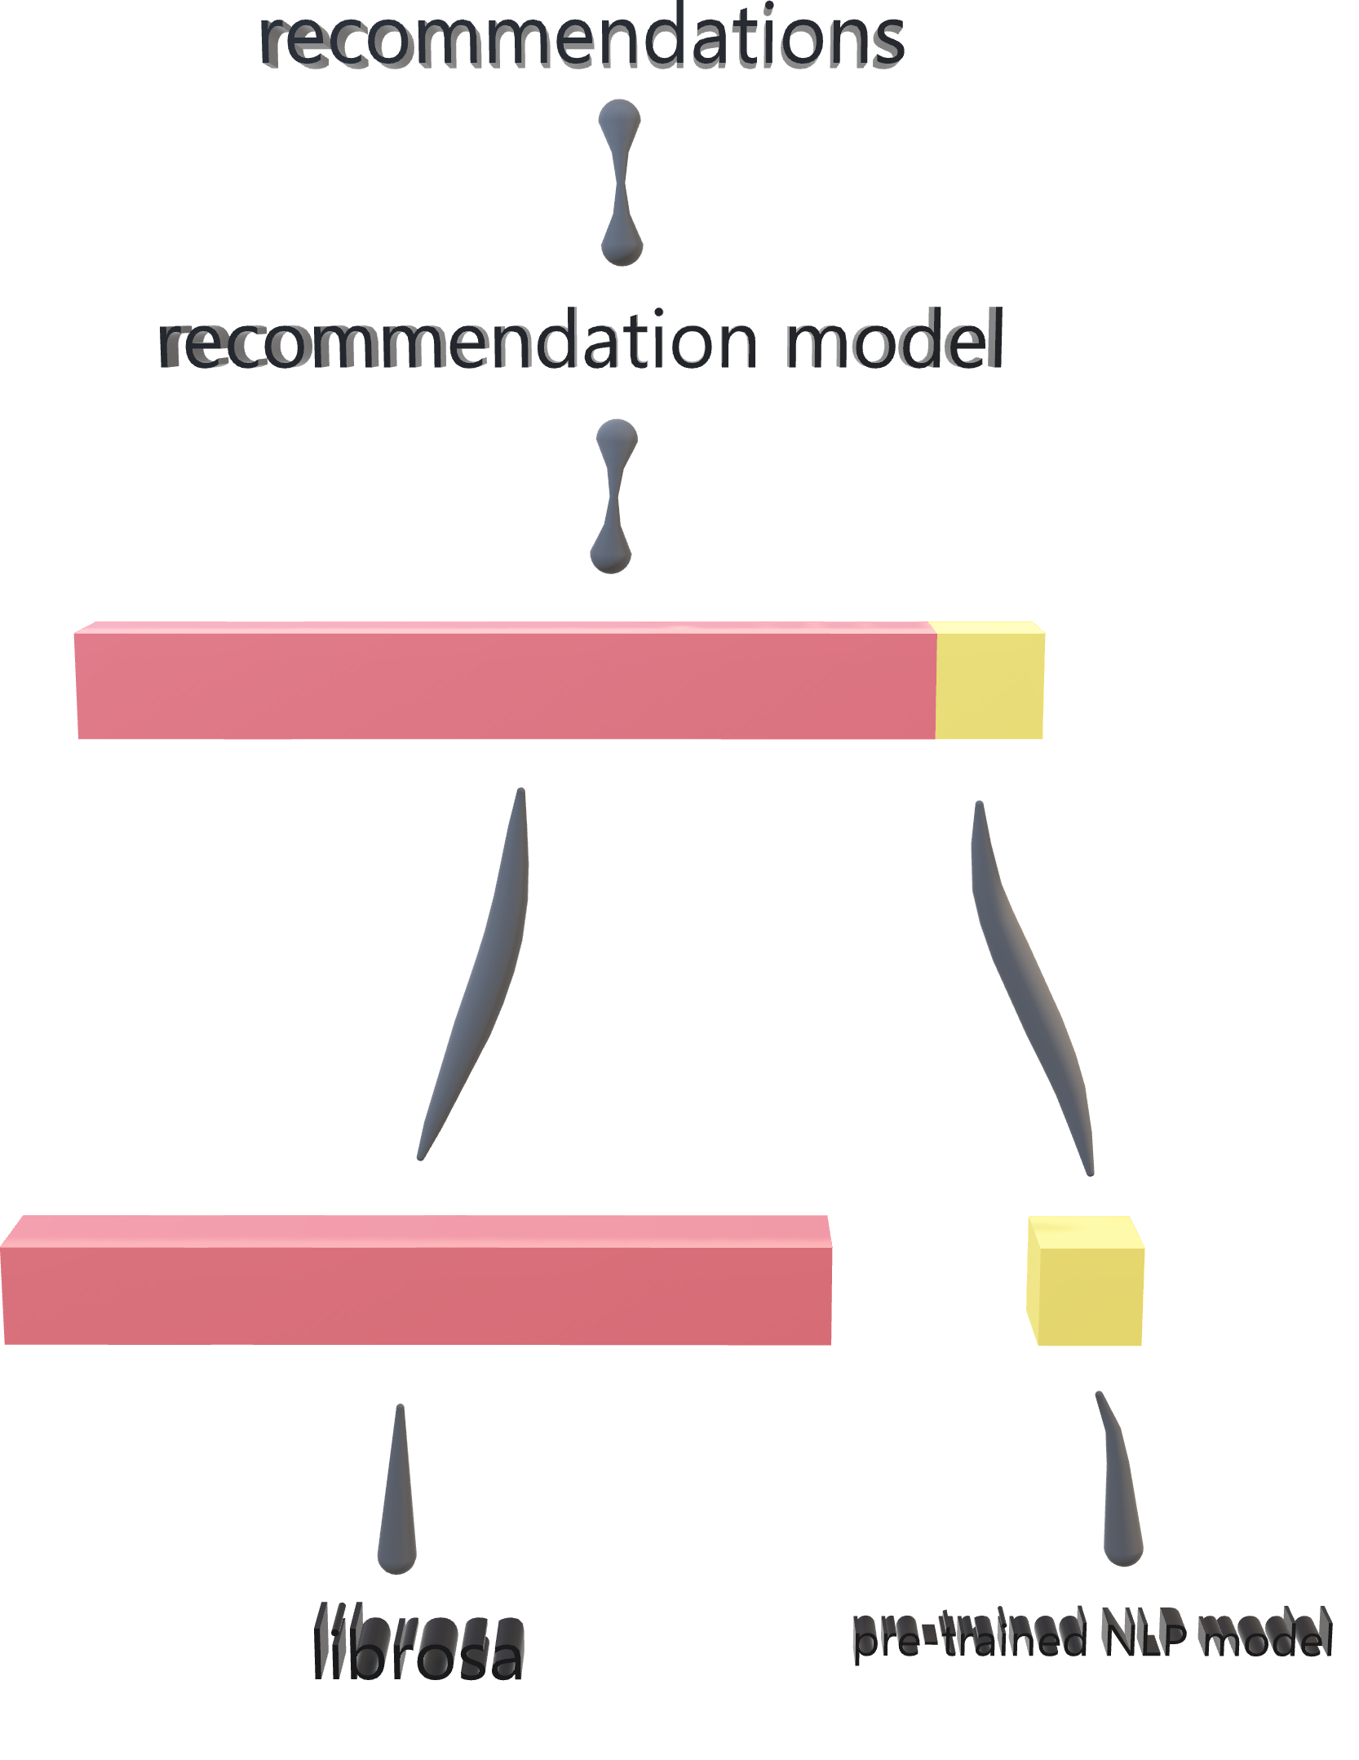
Our favorite model
that we have chosen using our extensive tests
Your new favorite songs
that you will listen for the rest of your life, from time to time obviously
Concatenated features
that will be fed to our favorite recommendation model

Slide 7
Dataset
Our dataset consists of 1640 songs over ~19 genres.
We act carefully not to create a biased dataset but, due to our collection methods, dataset might be a little biased towards an orientation.
We extracted 27 different features of a song.
One of the features is mood information extracted from song lyrics, so we had to collect these lyrics too. We did that using Genius API.
This was an exhausting process due to the computation power we have.

Slide 8
Evaluation and Application
Accuracy is the metric we think is appropriate for this project.
We label songs either 0 or 1 (liked or not). Then we train our model on the taste of music we got and recommend 10 songs with the highest scores.
Since our evaluation includes human factors a lot, these scores are open to discussion.

Slide 9
Scores we got
We used ourselves to select our favorite model.
We used KNN, Random Forest Classifier, Logistic Regression, and a neural network with an input layer, one hidden layer and an output layer.
Scores:
KNN: 0.55
Random Forest: 0.8
Logistic Regression: 0.85
Neural Network: ranging from 0.50 to 0.90

Slide 10
Scores we got
Ourselves:
Gökalp: 0.7
Mete: 0.4
Abdullah: 0.1
Other people’s accuracy:
Person 1: 0.4
Person 2: 1.0
Person 3: 0.8
Person 4: 0.7
Person 5: 0.8
Person 6: 0.6

Slide 11
Scores we got: Our opinion on that matter
Thinking about Spotify’s recommendation while using the “enhance” button on a playlist, or any other way, we generally don’t like the songs that have is recommended to us. Also, when we asked about their likes, we got answers like “Yeah, I will listen to these if someone opens it.” and “I added one to my playlist.”. This shows that “liking” means different things to different people and the “liking” threshold differs from person to person. That’s why some of us produced 0.1 accuracies while others produced 1.0. Also, we believe that the dataset is biased towards the jazz genre. This is another reason for that. This experiment should be continued to be carried out to get a valid score that is satisfying enough.

Slide 12
Pros
Cons
Since our approach is content-based, we do not face the cold start problem.
Our model does work well enough with a small number of songs.
Our model is easy to use and easy to integrate to lots of situations since the model is fast and input size, output size and, rating is easy to change.
Our model is ready to be used in a real-life application.
Dataset is too small, and evaluation depends on small number of songs with large number of features. This makes the model too depending on data.
Our model requires lyrics in English only, due to Natural Language Processing involvement.
NLP model is not good enough for sentiment analysis. Also, sentiment of songs depends on music too, not just on lyrics.
Some lyrics are poor, such as Turkish and Korean samples have been observed as well as meaningless ones. This is due to Genius API.
Our data consist duplicate entries.
Recommendation by a CNN might outperform our approach since it will extract the useful features better than us. We have little domain knowledge.

